Slide 1
View Object
(Section 3)

Slide 2
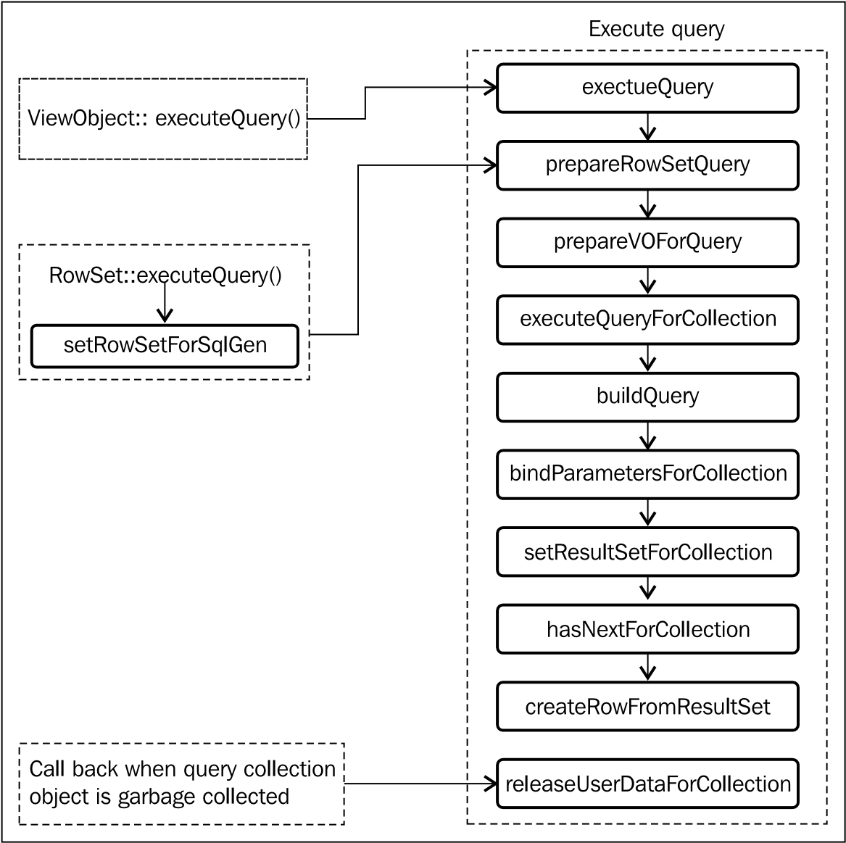
Lifecycle callback methods of a view object

Slide 3
What happens when a client invokes executeQuery() on a view object instance?
executeQuery(): when a client calls executeQuery() on the view object. This method in turn engages the default row set for the view object in the query execution cycle, and delegates the call for further processing.
prepareRowSetForQuery(ViewRowSetImpl vrs): prepares the row set for query execution. to assign bind variable values or modify the WHERE clause conditionally, before executing the query for a specific row set. This method also gets executed before the count query methods such as getQueryHitCount()and getCappedQueryHitCount()

Slide 4
What happens when a client invokes executeQuery() on a view object instance?
prepareVOForQuery(): prepares the row set for query execution. to assign bind variable values or modify the WHERE clause conditionally, just before executing the query for a view object. .Logically, you will override this method if you want to alter the query or to set bind variable values at the view object level, which needs to be reflected in all containing row sets.
executeQueryForCollection(Object qc, Object[] params, int noUserParams):before the row set starts executing the query. If this method is overridden, the custom logic will be applied to all row sets owned by this view object. Note that you should not use the executeQueryForCollection() method to alter the bind variable value or modify queries at runtime.
framework extracts the bind variable values before calling executeQueryForCollection() at runtime
this method will never get engaged with count queries So your custom logic will not be considered in count queries.

Slide 5
What happens when a client invokes executeQuery() on a view object instance?
buildQuery (int noUserParams, boolean forRowCount): This method builds the native SQL statement. While generating the query, the framework also provides database specific interpretation for range paging, view criteria, and effective dated attributes.
bindParametersForCollection(QueryCollection qc, Object[] params, PreparedStatement stm): This method binds parameter values for the SQL statement at runtime. This includes bind parameters appearing in the query statement as well as the range paging parameters supplied by the framework.
setResultSetForCollection(Object qc, ResultSet rs): This method is responsible for storing results of query execution for further processing.
hasNextForCollection(Object qc): This method is invoked when a client starts to iterate over the rows set by calling hasNext() on the row set iterator.
createRowFromResultSet(Object iqc, ResultSet resultSet): This method creates a view row instance from the query result. The new view rows are created when the client traverses through the result set.
releaseUserDataForCollection (Object qc, Object data): This is a callback method which can be overridden to add some resource cleanup.

Slide 6
Count queries in a view object
A view object also exposes APIs to find total records returned by the query. This is used by many clients in different scenarios
The view object exposes multiple methods for finding the row count.
getRowCount(): This method fetches all the rows from the database and then counts each row to find the total row count.
getQueryHitCount(ViewRowSetImpl viewRowSet): This method executes the count query on the database to return the row count for each invocation by the client.
getEstimatedRowCount(): This method finds the row count by calling getQueryHitCount() for the first invocation. Once the row count is read from the database, the framework keeps the estimated row count up-to-date as rows are inserted and removed. So the second call from the client does not result in a fresh database query.
ViewObjectImpl::getCappedQueryHitCount(ViewRowSetImpl viewRowSet, oracle.jbo.Row[] masterRows, long oldCap, long cap): if the number of records in the database is huge , this method provides a cap argument to the count query so that the count query generated at runtime has a special clause to limit the number of rows scanned.

Slide 7
Building programmatically managed view objects
If your view objects need to read data from a custom data source, and you still want to leverage the declarative features offered by view objects then you can build a programmatic view object by overriding the default lifecycle callback method for populating the row set with data from the custom data source.
To build a programmatic view object, you are supposed to override the following lifecycle callback methods in the corresponding view object implementation java class: executeQueryForCollection, hasNextForCollection, createRowFromResultSet, getQueryHitCount, getCappedQueryHitCount, and releaseUserDataForCollection.

Slide 8
Intercepting query generation for view criteria
The view object allows you to hook custom codes to intercept the default query generation logic at runtime for applied view criteria.
Using a custom view criteria adapter for the view object
Overriding getViewCriteriaClause(boolean forQuery) or getCriteriaItemClause(ViewCriteriaItem vci) in the view object implementation class

Slide 9
Using a custom view criteria adapter
You may use this feature to override the default SQL WHERE clause generation logic provided by the framework for the view criteria applied on a view object. When you execute a view object after applying one or more view criteria, the framework uses oracle.jbo.server.CriteriaAdapterImpl to interpret the applied view criteria and convert them to WHERE clauses at runtime.
public class CustomCriteriaAdapterImpl extends CriteriaAdapterImpl implements CriteriaAdapter {
public String getCriteriaClause(ViewCriteria criteria) {
}

Slide 10
Using a custom view criteria adapter
To return your own oracle.jbo .CriteriaAdapter implementation, override the getCriteriaAdapter() method in the view object implementation class
public CriteriaAdapter getCriteriaAdapter() {
CriteriaAdapterImpl customCriteriaAdapterImpl = new CustomCriteriaAdapterImpl();
return customCriteriaAdapterImpl; }
To globally replace the default view criteria adapter, set the configuration property, jbo.ViewCriteriaAdapter, to the fully-qualified class name of your oracle.jbo .

Slide 11
Overriding getViewCriteriaClause in the view object implementation class
This method builds the WHERE clause expression from the applied view criteria before executing the query.
public String getViewCriteriaClause(boolean forQuery) {
ViewCriteria[] vcs =
getApplyViewCriterias(forQuery ? ViewCriteria.CRITERIA_MODE_QUERY
: ViewCriteria.CRITERIA_MODE_CACHE);
if (vcs != null && vcs.length > 0) {
for (ViewCriteria vc : vcs) {
if (!vc.isUpperColumns()) {
vc.setUpperColumns(true);
}}}
return super.getViewCriteriaClause(forQuery);
}

Slide 12
Overriding getCriteriaItemClause(ViewCriteriaItem vci)
This method gets engaged when the framework tries to interpret each view criteria item present in the view criteria for building the WHERE clause fragments. This method can be overridden to return the custom WHERE clause fragments for a specific ViewCriteriaItem.

Slide 13
Tips on overriding getViewCriteriaClause() and getCriteriaItemClause()
The view criteria callbacks getCriteriaItemClause and getViewCriteriaClause will be invoked only when the framework tries to build the WHERE clause for the very first execution of the query, or when the view criteria structure changes later which may affect the WHERE clause fragments.
When you override getCriteriaItemClause() and getViewCriteriaClause(), make sure the overridden method has logic for handling both the query on the database as well as in-memory.
When you check for specific view criteria names from these methods, check if the view criteria name contains a specific name (e.g if(vcName. contains("SomeVCName")) {...}) instead of applying an equality check.

Slide 14
Passing parameters to a SQL IN clause using oracle.jbo.domain.Array
Oracle ADF Business Components support passing arguments to a SQL IN clause using the oracle.jbo.domain.Array domain type. Of course, you can build the IN clause dynamically with comma delimited arguments. However, this is not considered as best practice from the performance angle. Passing values through a bind parameter improves the performance of query execution by avoiding the repeated parsing of the SQL.

Slide 15
Using oracle.jbo.domain.Array as a NamedWhereClauseParam value
The column type represents the database object name used for holding values from oracle.jbo.Array. Typically this would be a database table object. An example is given as follows:
CREATE OR REPLACE TYPE "CHARTABLETYPE" AS TABLE OF VARCHAR2 (4000);
The element type represents the data type for Array members.

Slide 16
Using oracle.jbo.domain.Array as a NamedWhereClauseParam value
The column type represents the database object name used for holding values from oracle.jbo.Array. Typically this would be a database table object. An example is given as follows:
CREATE OR REPLACE TYPE "CHARTABLETYPE" AS TABLE OF VARCHAR2 (4000);
The element type represents the data type for Array members.

Slide 17
Using oracle.jbo.domain.Array as a NamedWhereClauseParam value
public Array getValueAsArray(String[] deptArray) {
Array arr = null;
try {
arr = new Array(deptArray);
HashMap context = new HashMap();
context.put(DomainContext.ELEMENT_SQL_NAME, "CHARTABLETYPE");
context.put(DomainContext.ELEMENT_TYPE, String.class);
arr.setContext(null, null, context);
} catch (Exception ex) { ex.printStackTrace(); }
return arr; }
deptVOImpl.defineNamedWhereClauseParam("ArrayOfDeptNames", null, null);
deptVOImpl.setWhereClause("DepartmentEO.DEPARTMENT_NAME MEMBER OF CAST(:ArrayOfDeptNames AS CHARTABLETYPE)"); deptVOImpl.setNamedWhereClauseParam("ArrayOfDeptNames", getValueAsArray(deptNamesArray));

Slide 18
Using oracle.jbo.domain.Array as a bind variable value for a view criteria item
Define a bind variable of the type oracle.jbo.domain.Array. When defining a bind variable, select the type as Array. In the property inspector window, set Column Type as the database object name that you defined for holding values from oracle.jbo.Array, and Element Type as the item type that you store in the Array object.
Create or edit the view criteria and specify the Array type bind variable as parameter for the desired view criteria item which is supposed to take multiple parameter values.
Generate the view object implementation Java class for the view object, if it does not exist. Open the view object implementation class and override the getCriteriaItemClause(ViewCriteriaItem vci) method to return the customized WHERE clause fragment which takes an Array typed bind variable as discussed in the following example.

Slide 19
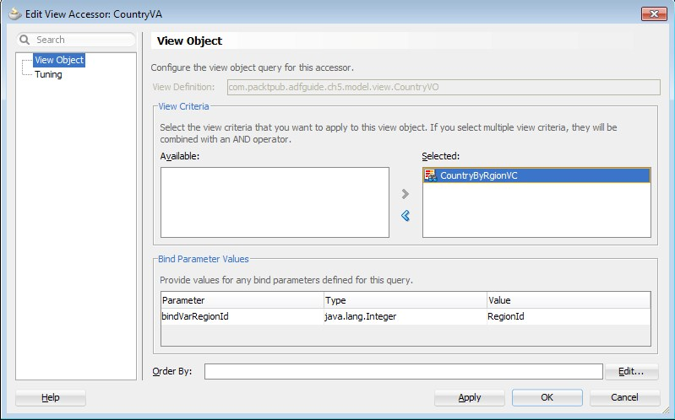
Defining a cascading list of values
In some scenarios the LOV needs to be refreshed whenever the value for dependency attributes change. The ADF Business Component framework supports such LOV definitions through a special type known as the Cascading (or Dependent) LOV.

Slide 20
Switching the LOV at runtime
There are some business cases where you may need to dynamically switch the data source (source view object) used for the LOV based on specific conditions. The business requirement is that depending on the logged-in user role, LOV should query different database tables to display the departments.
The framework uses a switcher attribute to decide the ID of the LOV that needs to be shown at runtime. Typically a transient attribute is marked as the LOV switcher, whose value is evaluated to one of the LOV IDs defined on the attribute.
Add multiple LOVs. When you add a second LOV, you may notice two drop-down lists in the screen, namely List Type UI Hint and List of Values Switcher.
New Transient Attribute :
Click on the List of Values Switcher drop-down and then select the appropriate transient attribute that you defined in step 4.

Slide 21
Reading and writing XML data
The ADF view object has support for writing queried data into XML format and for reading XML documents in order to apply changes to data. You will be using writeXML() and readXML() methods defined on the view object implementation class for the purpose of achieving the previously mentioned functionalities.
writeXML(): This produces an XML document for rows in a view object row set. You may use this API to export data from the database in the XML format in a language-neutral way for use by third party systems.
readXML(): This processes all rows from an incoming XML document. This is useful to update the data with an incoming XML document.

Slide 22
Using writeXML
writeXML(depthCount, options) on the oracle.jbo.Row object. The depthCount parameter in the writeXML() call represents what level system should traverse the rows in the view object hierarchy while creating the node structure. For example, depthCount = -1 indicates that the row object should render all child rows by traversing all the view links.
ViewObject vo = am.findViewObject("Departments");
Key k = new Key(new Object[] { 10 });
Row deptRow = vo.findByKey(k, 1)[0];
Node node = deptRow.writeXML(-1, XMLInterface.XML_OPT_ALL_ROWS);
((XMLNode)node).print(System.out);

Slide 23
Using writeXML
Using writeXML() on a view object: This example renders all rows from a view object in XML by calling writeXML() on the view object.
While writing rows into XML, you can refine the rows by supplying a hash map that contains the names of the desired view object and its attributes. In this case, the framework will export only those rows that match the supplied view object names and attributes. writeXML(long options, HashMap voAttrRules)
HashMap viewDefMap = new HashMap(); viewDefMap.put("model.view.DepartmentVO",
new String[] { "DepartmentId", "DepartmentName" });
Node node = vo.writeXML(-1, viewDefMap);
((XMLNode)node).print(System.out);

Slide 24
Using readXML
Using readXML() on a view object: You can call the readXML() API on a view object class to read in the data from the incoming XML. When you call readXML() on a view object passing an XML filename, the framework will read the XML content and will take the following actions for each node present in the XML:
Update existing view rows attribute values from XML.
Create a new row, if the row that you supplied in the XML has not been retrieved by calling findByKey(). If the primary key for the new row is populated using DB Sequence or Groovy expression, remove that attribute from the XML. ADF runtime will take care of populating these attribute values.
Deletes the view row if the corresponding XML element has bc4jaction='remove'.

Slide 25
Using readXML
public void readRowsFromXML(ApplicationModule am) throws IOException {
ViewObject vo = am.findViewObject("Departments"); try {
Element xmlToRead = getInsertUpdateDeleteXMLGram("dept.xml");
vo.readXML(xmlToRead, -1);
} catch (Exception ex) {
ex.printStackTrace();
}
}
private Element getInsertUpdateDeleteXMLGram(String xmlurl) throws
XMLParseException, SAXException, IOException {
URL xmlURL = CRUDXMLTestClient.class.getResource(xmlurl);
DOMParser dp = new DOMParser(); dp.parse(xmlURL);
return dp.getDocument().getDocumentElement(); }

